Slide 1
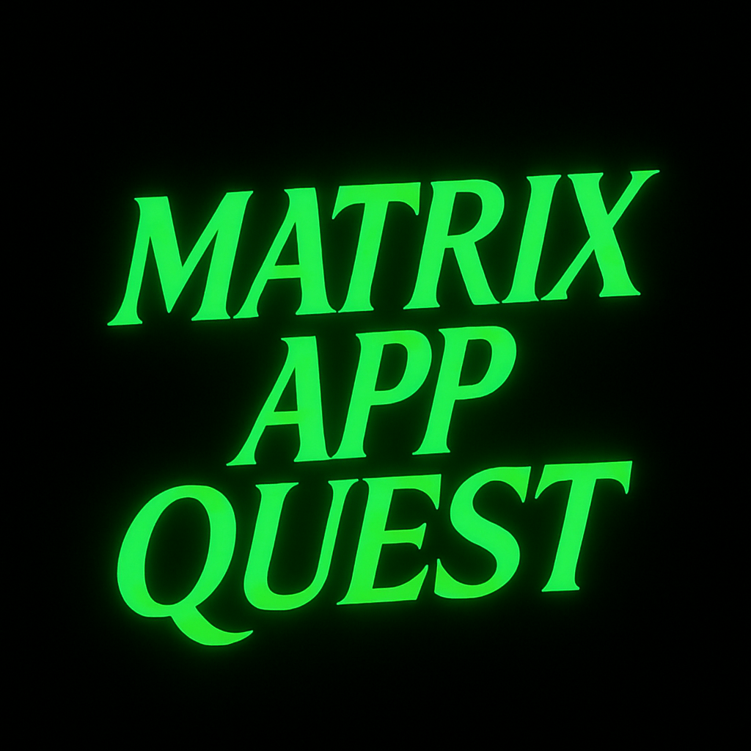
Developers: Gal Lev Avraham Evdaev

Slide 2
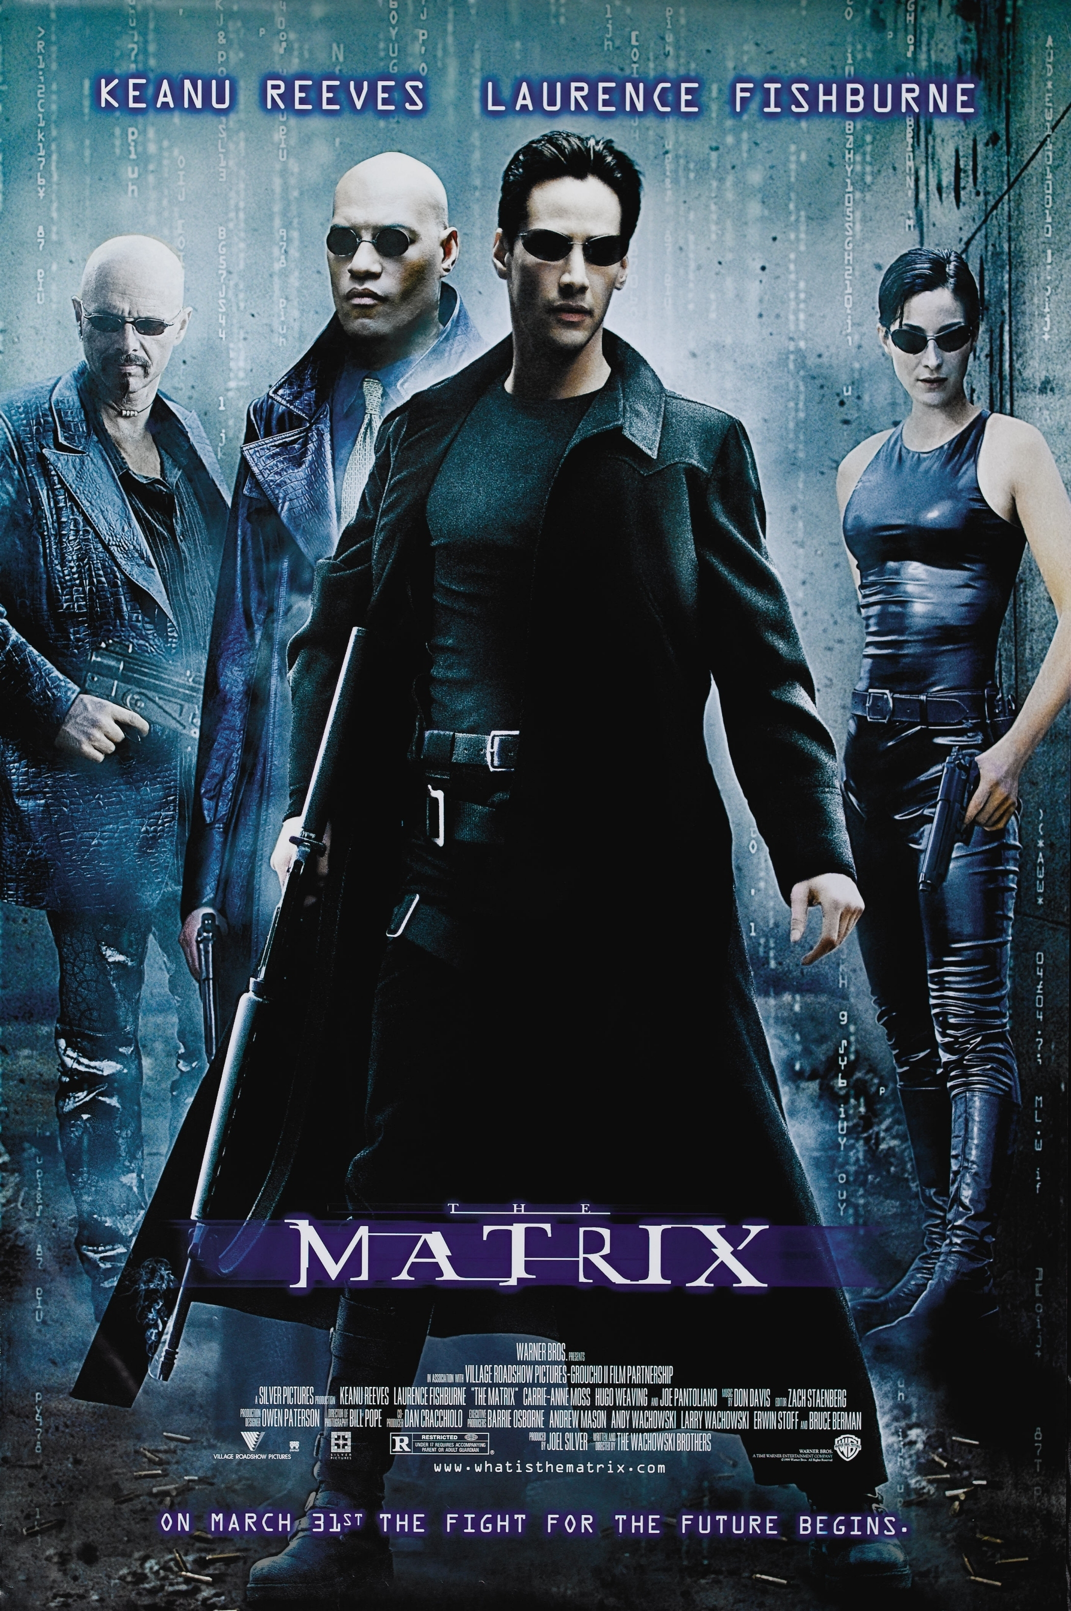
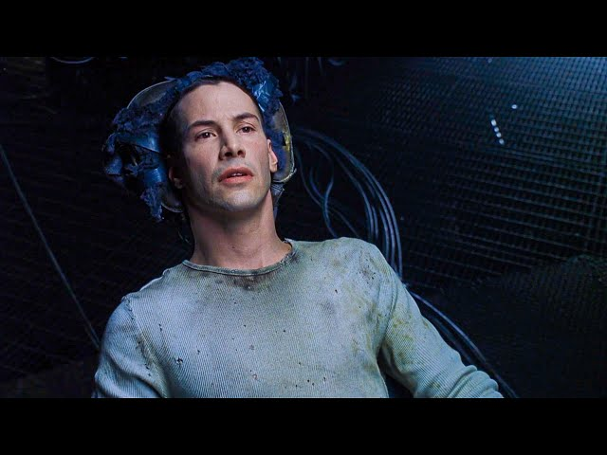
Project description
This is a multiplayer card game inspired by the The Matrix movie, set in a computer science-themed world.
The target audience is young players—we aim to introduce them to CS concepts in a fun and engaging way.
Players collect "App" cards to reach 7 points and win, using strategy, counteractions, and point accumulation.
Just like Neo in The Matrix downloads skills to succeed in escaping the Matrix, players must "download" apps (skills) to succeed.
https://youtu.be/w_8NsPQBdV0

Slide 3


Slide 4


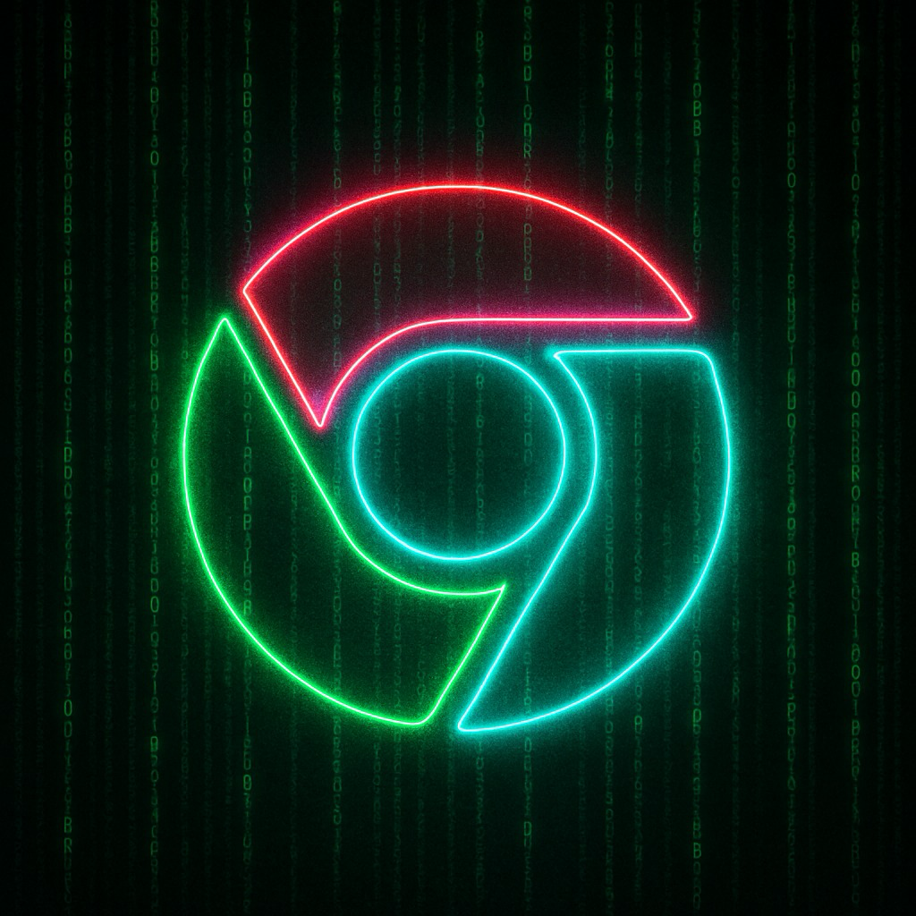

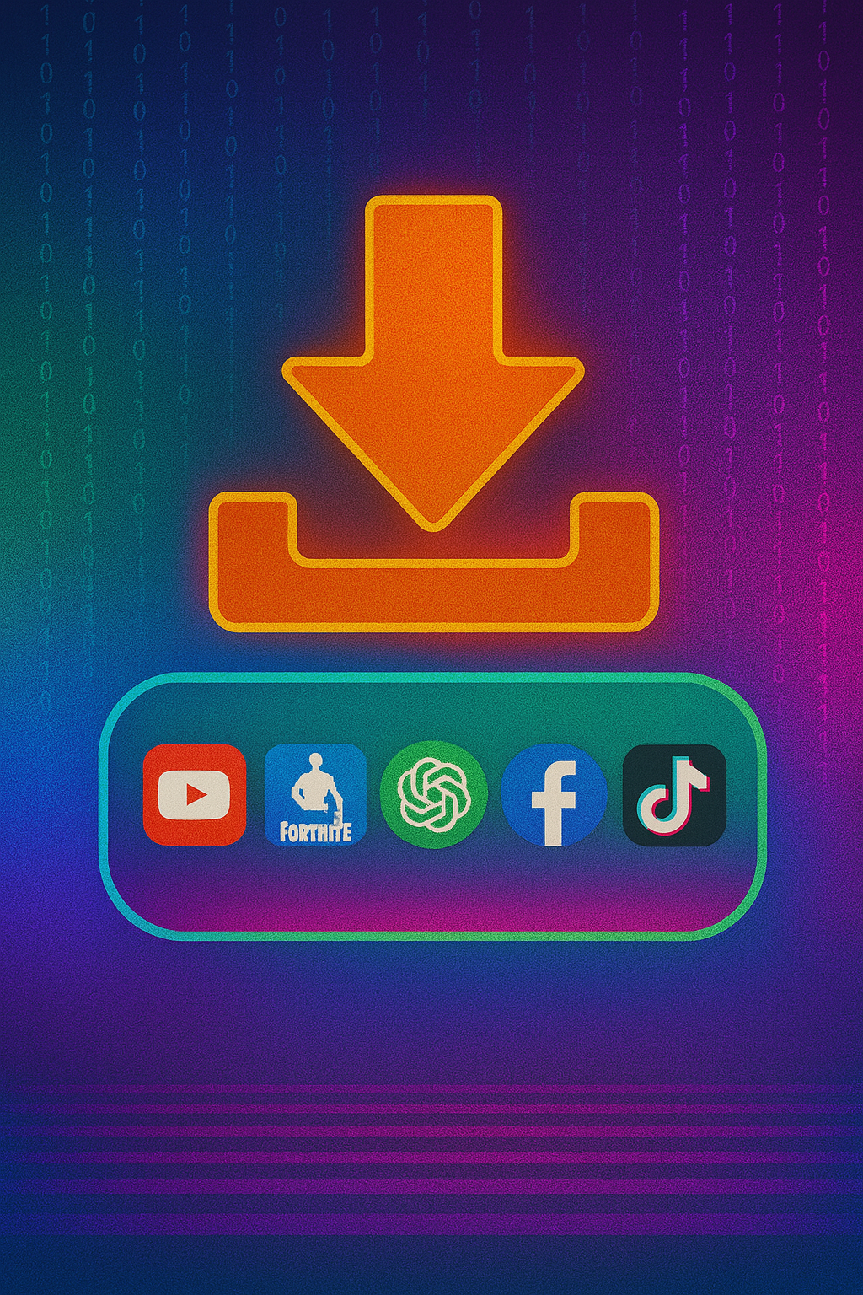
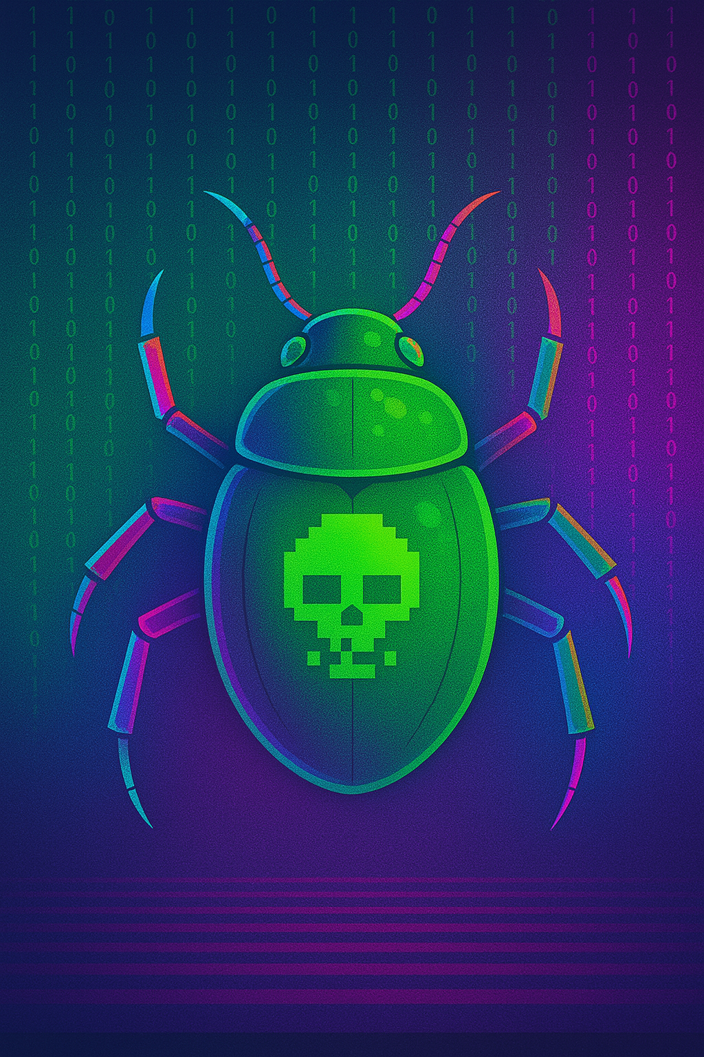

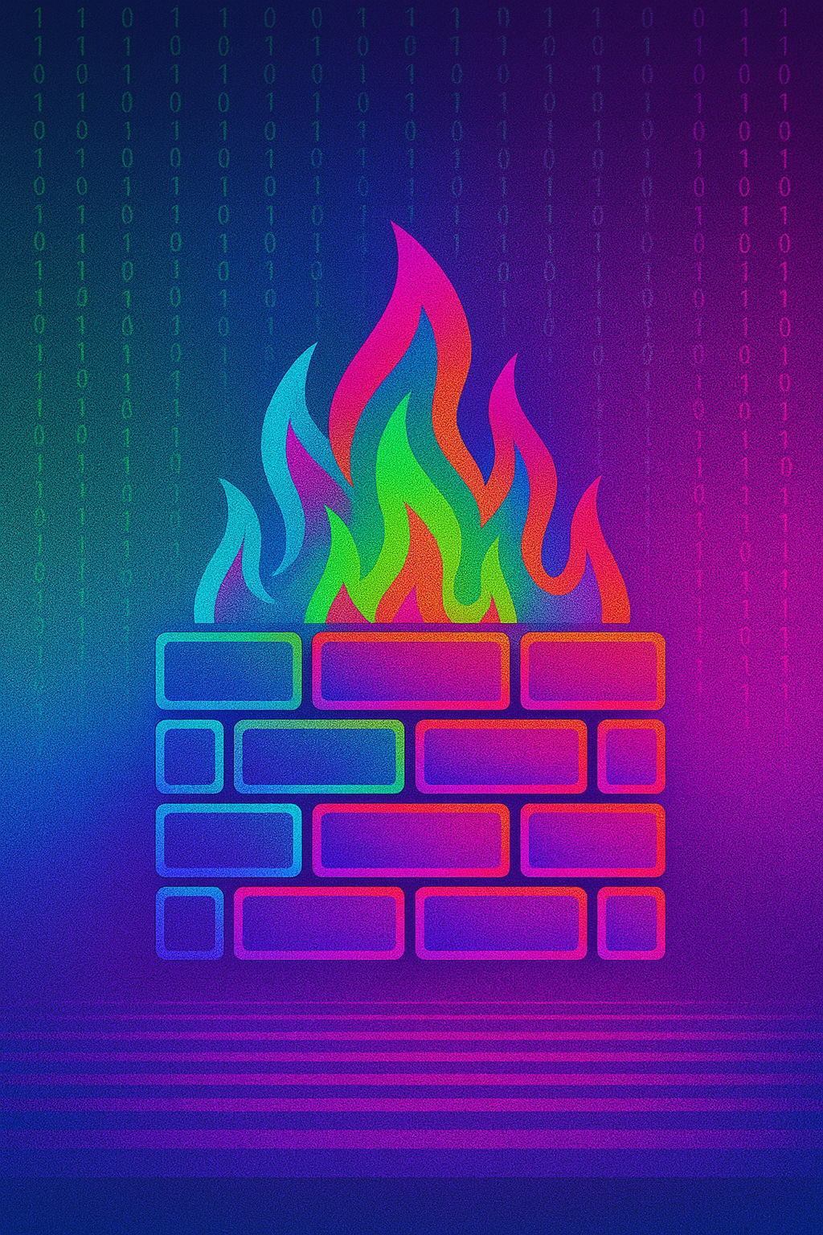
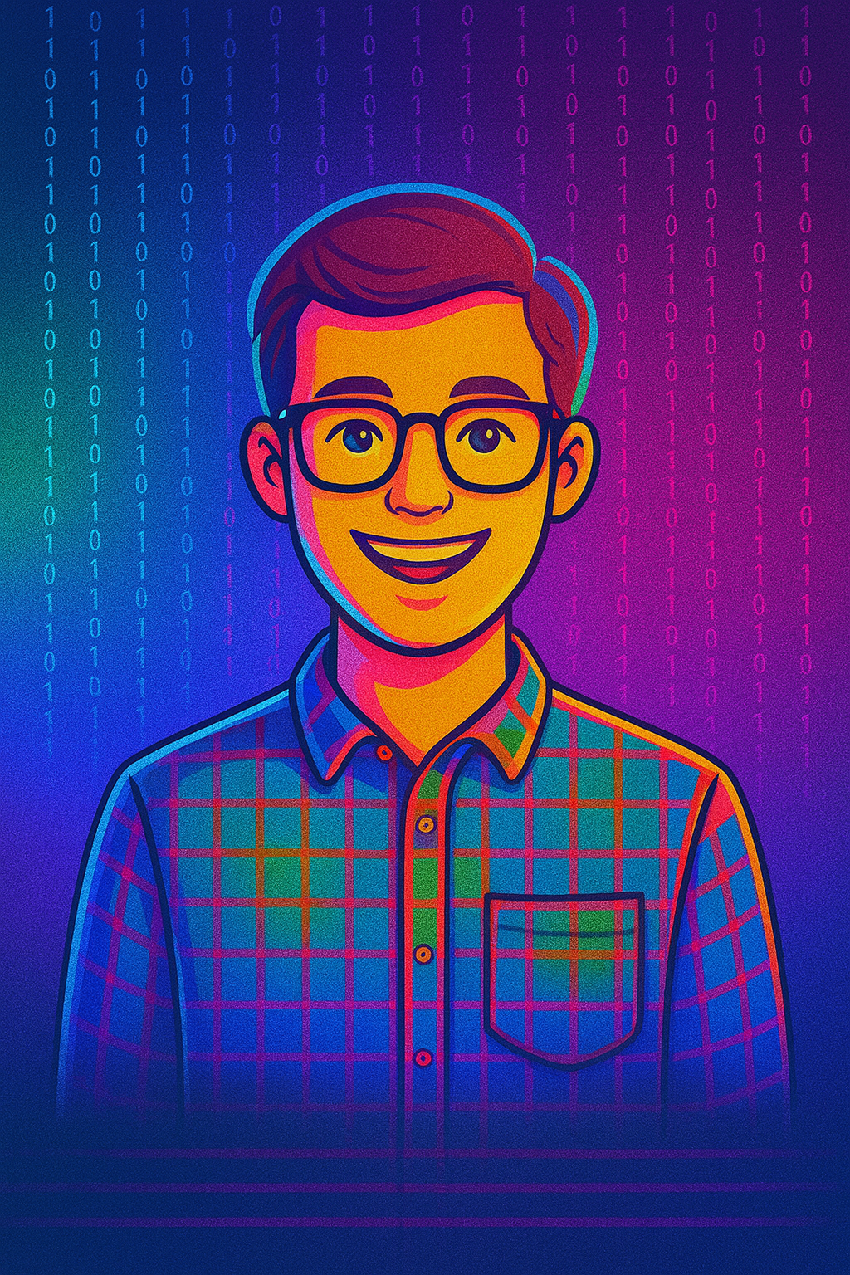
Cards & Apps
App Cards: Each card represents a real-world app where each app has a unique point value:
Download App: Allows a player to draw a random App card from the App pile.
Hacker Theft: Allows Player A to steal a random App card from Player B (if Player B has any). If Player B does not play an "IT Guy” card, the App card is transferred to Player A.
IT Guy: Counters the "Hacker Theft" card and prevents an App card from being stolen.
1
2
3
4
Computer Virus: Forces Player B (chosen by Player A) to return a random App card to the table.
Firewall: Counters the "Computer Virus" attack and prevents an App card from being returned to the table.

Slide 5
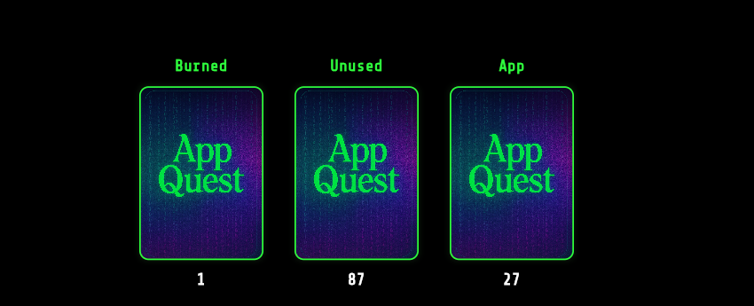
Game Rules
Each turn, a player either activates one of their cards or discards a turn by removing a card from their hand.
Players must begin and end their turn with 3 Play Cards.
The first player to reach 7 points wins the game!
In the center of the screen are three card piles:
Burned Cards – Played (non-App) cards go here.
Unused Cards – Players draw from this pile at the start of their turn.
App Cards – Contains all App cards, including unclaimed ones and those returned via the "Computer Virus" card.

Slide 6
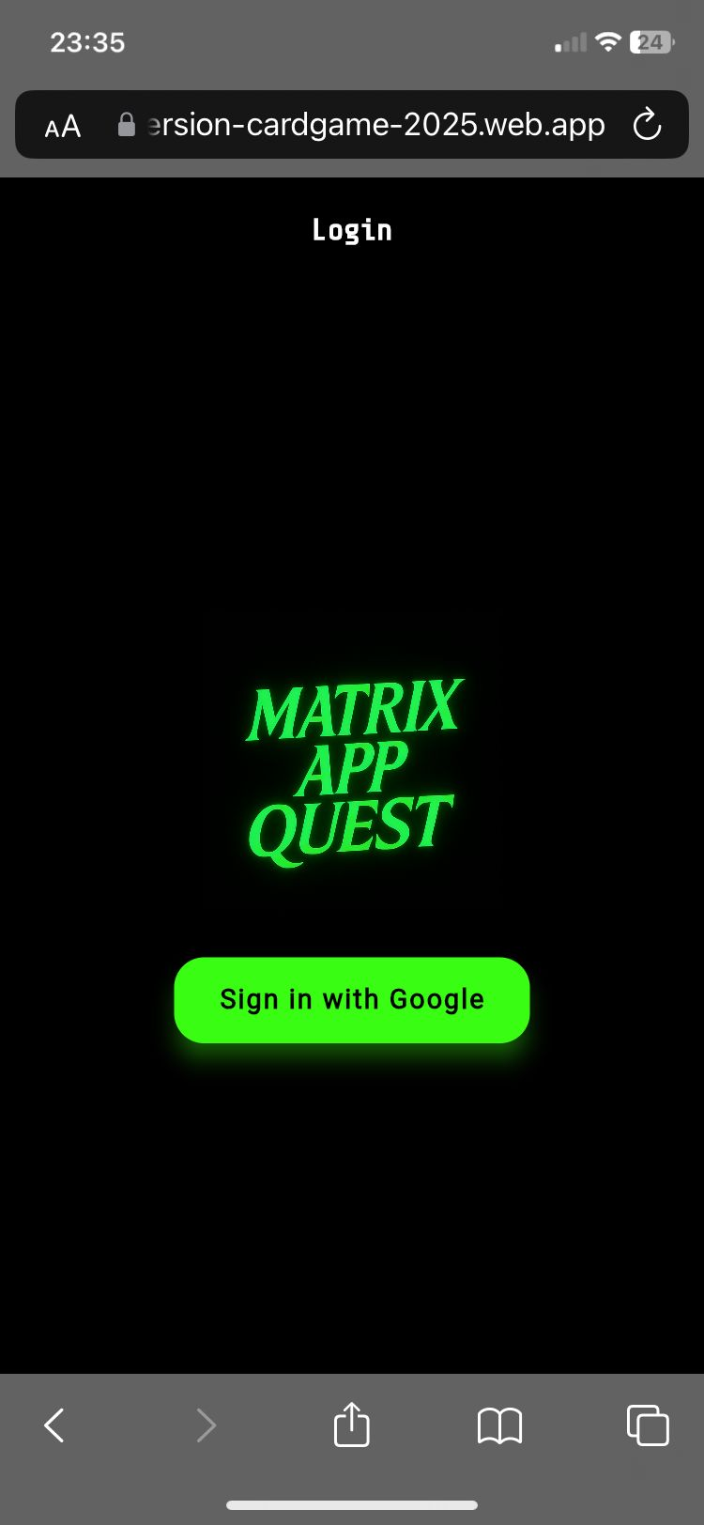
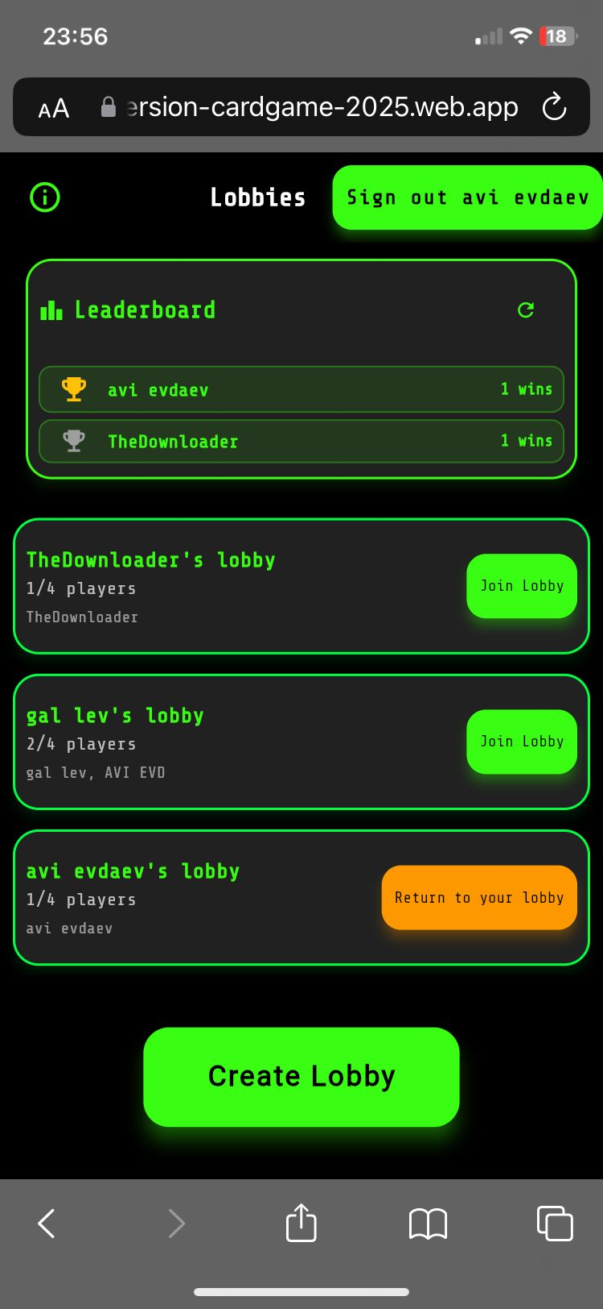
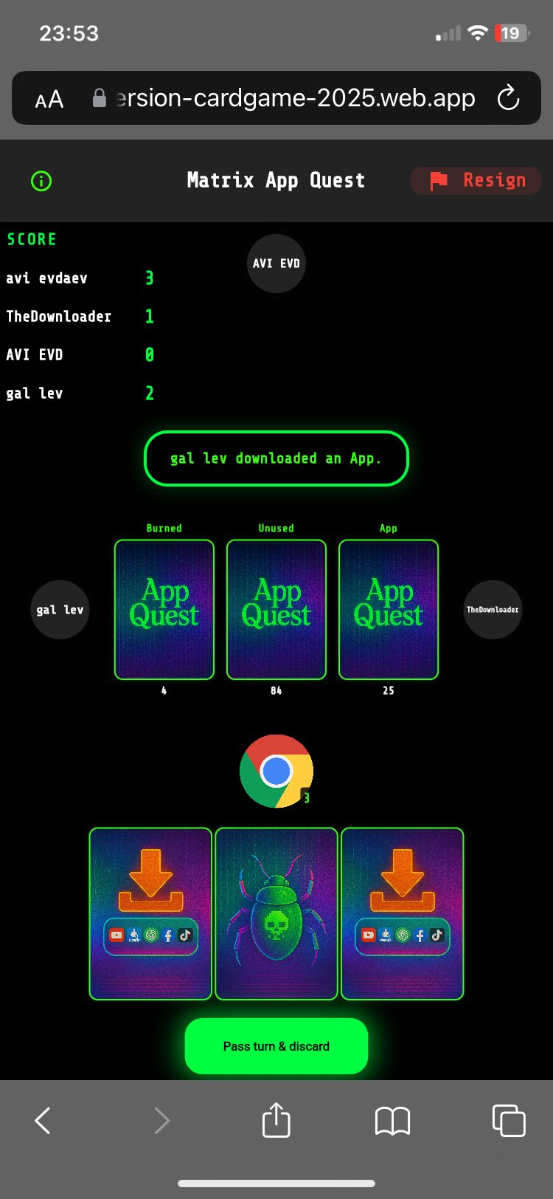
Views
The main views we implemented are the following:
Login
Lobby
Game Table

Slide 7
What has changed since the alpha presentation?
Design: UI/UX – brighter, more colorful cards and improved overall visual design.
Features: Scoring Table – persistent Firestore data shows player rankings on the lobby screen.
Latency: We use both Realtime Database and Firestore to boost performance and make the game more interactive.

Slide 8


Storage
Scores Table
Online Users,
Lobbies,
Games
FireStore DB persistent memory
RealTime DB volatile memory

Slide 9
Hybrid Storage Access
Reads: Direct database access for real-time synchronization (but no direct Firestore access)
Writes: Cloud Functions for secure, validated operations
Why This Hybrid Approach?
Real-Time Updates: Enables instant UI refresh through direct database access
Security: Write operations via Cloud Functions prevent cheating
Performance: Direct reads are faster than function calls
Validation: All business logic is enforced on the server side
This is a secure and efficient architecture that combines the best of both worlds: real-time performance with server-side security validation.

Slide 10
Logical Architecture
1. Google Authentication
FireBase Backend
2. Storage (firestore, RealTime)
3. Cloud Functions (logic)
4. FireBase SDK (Dart)
4. FireBase SDK (Dart)
4. FireBase SDK (Dart)
. . .
5. Frontend UI
5. Frontend UI
5. Frontend UI
Player 1 Device (Flutter web app)
Player 2 Device (Flutter web app)
Player k Device (Flutter web app)

Slide 11
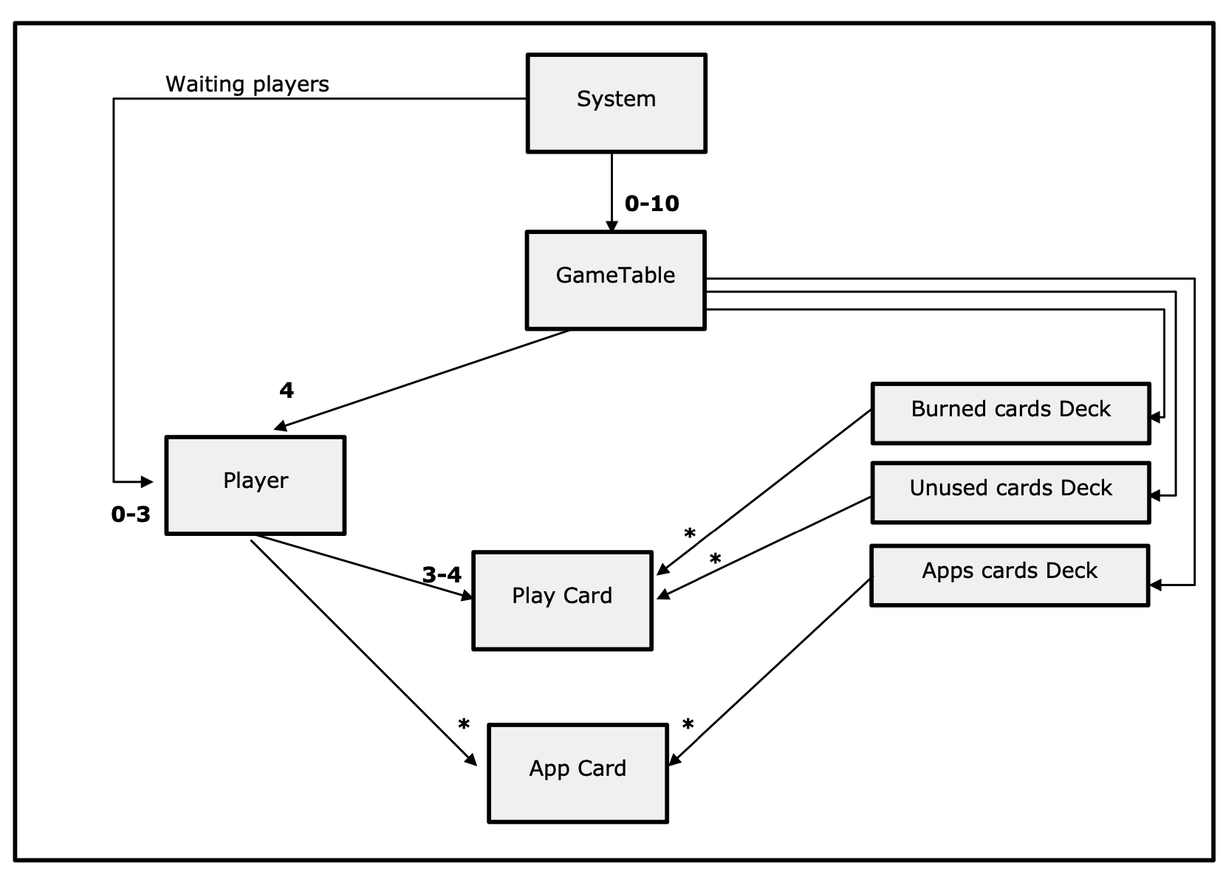
Design (Modules / Main classes)
Note: This is for illustration purposes only. JavaScript (Node.js) is not a class-based object-oriented language by default, so we did not implement classes.

Slide 12
Project Structure
MatrixAppQuest-Project/
├── frontend/ # Flutter app
│ ├── lib/
│ │ ├── main.dart # App entry point & auth
│ │ └── screens/
│ │ ├── login_screen.dart
│ │ ├── lobby_screen.dart
│ │ └── game_table_screen.dart
│ └── assets/ # Game images and fonts
├── backend/ # Firebase backend
│ ├── functions/
│ │ └── index.js # Backend game logic
│ ├── firebase.json # Firebase configuration
│ └── database.rules.json # Security rules
├── guides/
│ ├── USER_GUIDE.md
│ └── DEVELOPER_GUIDE.md
└── README.md

Slide 13
Summary
What went well We learned a lot about handling concurrent workloads, exploring different storage services, web programming, backend development, and building the frontend.
Main difficulties We weren’t familiar with the technologies beforehand, so we had to learn how to use them properly and understand their syntax along the way.
Potential extensions Since this is a game, the possibilities for expansion are endless. Some ideas we considered include adding sound effects, animations, new app and card types, and features like friend requests and game invites.
Use of generative AI As we were new to many technologies, we used both Google and ChatGPT to understand how things work and learn programming syntax. We also relied on AI for UI/UX tasks—both in designing graphics and writing interface content. And of course… for a looooot of debugging and understanding error messages ☺.

Slide 14
Thanks !

